Slide 1

Drug Discovery Company Management System
By Rayane Adam
Instructor: Dr. Abdallah Dabboussi
BIF375
Fall 2022

Slide 2

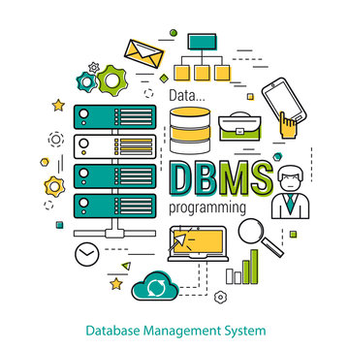
Table of Content
Introduction
ER Model
Relational Model
Implementation
Normalization
Users and Views

Slide 3

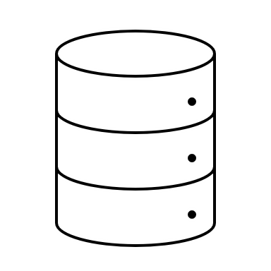
Introduction
What's Drug Discovery?
Why a DBMS?
How is it useful?

Slide 4
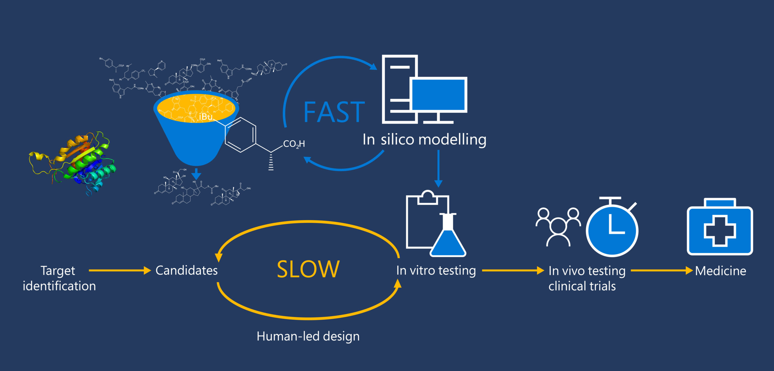

Slide 5
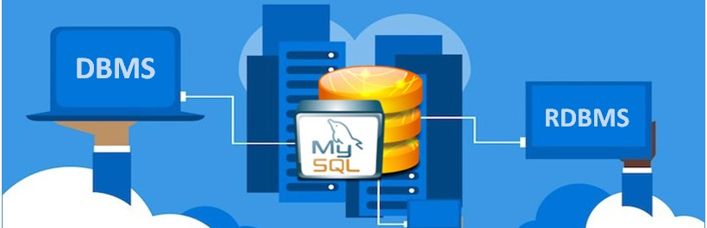
Why need a DBMS?
It's all about data

Slide 6


Drug Discovery for Genetic Diseases
Genes
Genetic Disorders
Test Trials
Drugs
Chemical Compounds

Slide 7


Entities/Relationships

Slide 8

Entities
Patient
Record
Disease
Gene
Drug
Chemical Compound
Variant
.

Slide 9
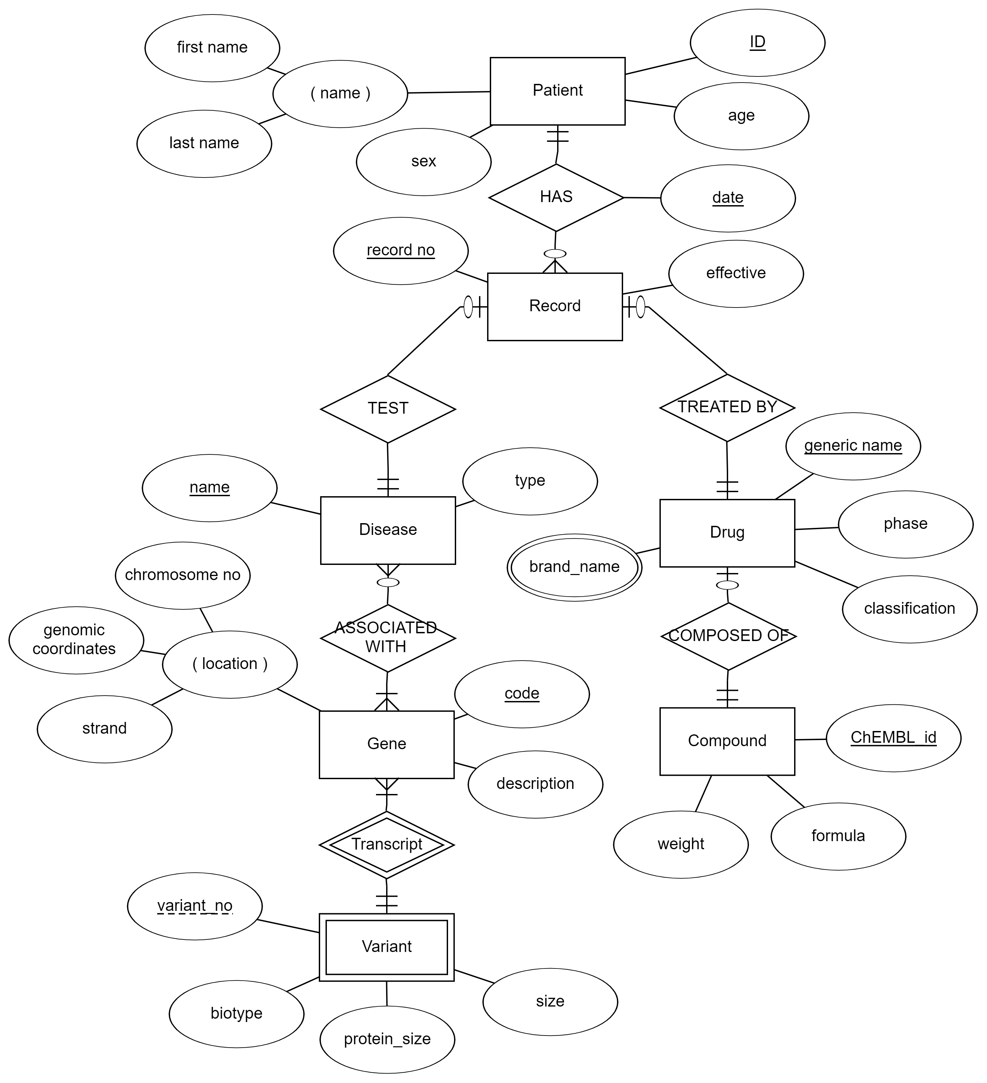

ER DIAGRAM

Slide 10
Relational Constraints
Domain
Key
Entity Integrity
Referential Integrity

Slide 11
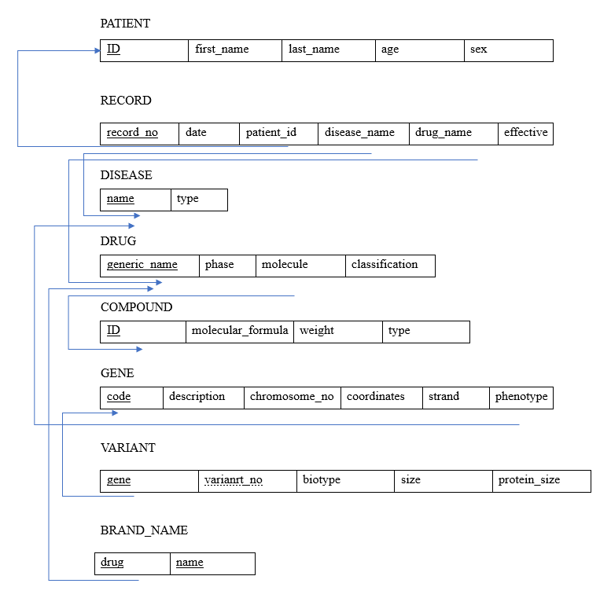
Relational Mapping
Strong Entities
Weak Entities
1:1 relationships
1:N relationships
M:N relationships
Multivalued Attributes

Slide 12

Implementation: Data Definition Language

Slide 13
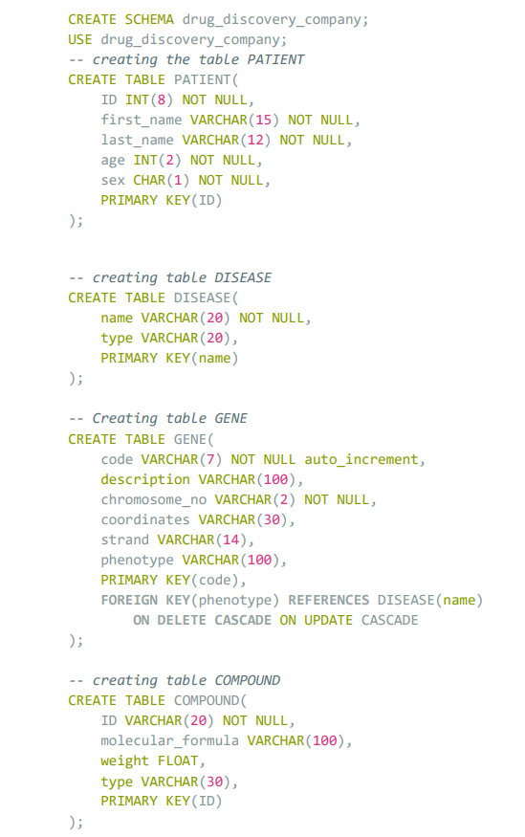
DDL

Slide 14
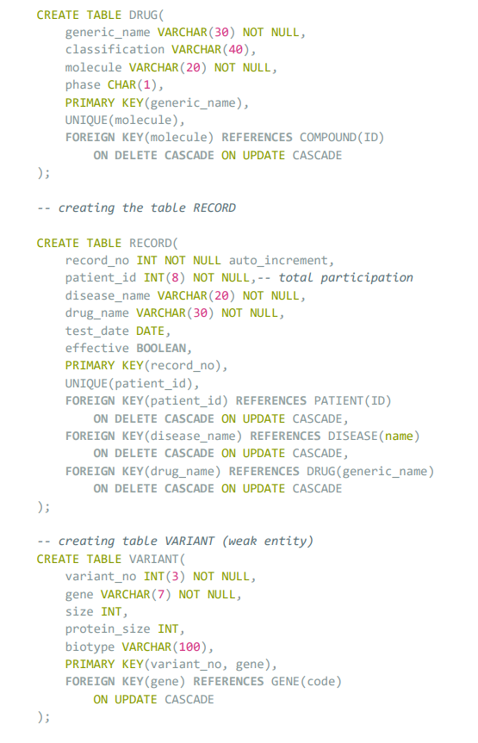
DDL

Slide 15
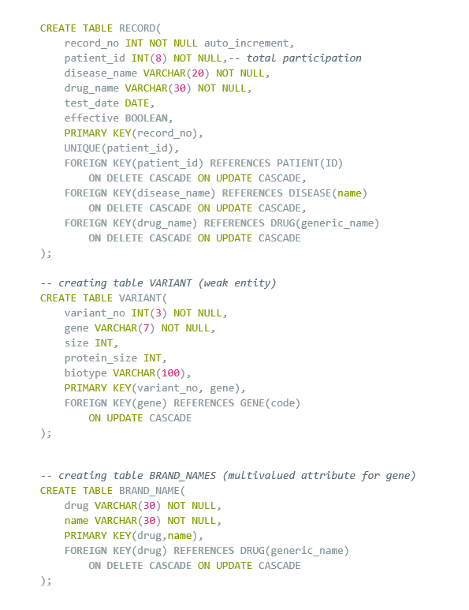
DDL

Slide 16
Implementation: Data Manipulation Language

Slide 17
DML
Data were:
Generated randomly using python scripts and re module to transform to SQL scripts: PATIENT and RECORD
Withdrawn from public datasets, especially scientific data: DRUG and COMPOUND from ChEMBL, GENE, DISEASE and VARIANT from ENSEMBLE

Slide 18
Implementation: Data Query Language

Slide 19
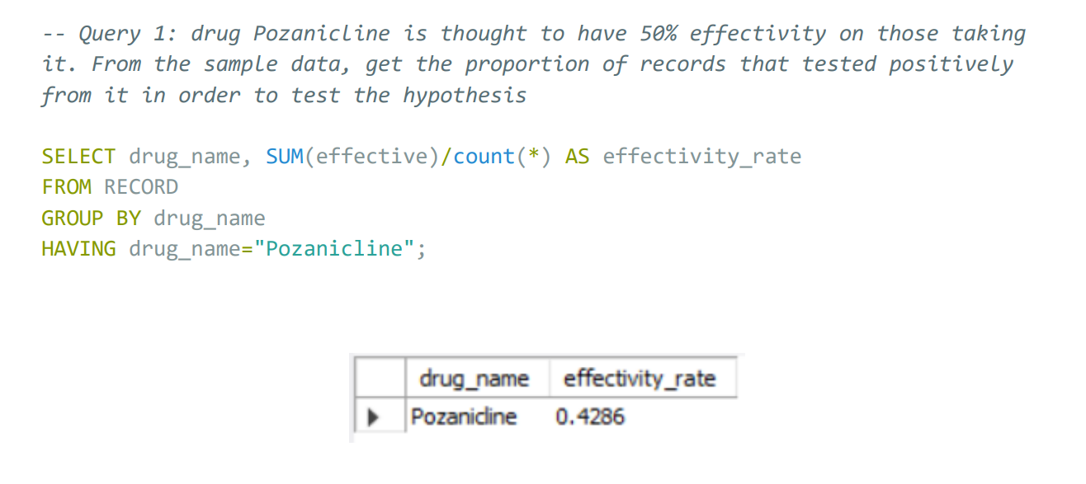
Query
This query allows us to apply Z-Hypothesis testing on the sample statistic proportion, to conclude the effectiveness of a drug with respect to a certain confidence level

Slide 20
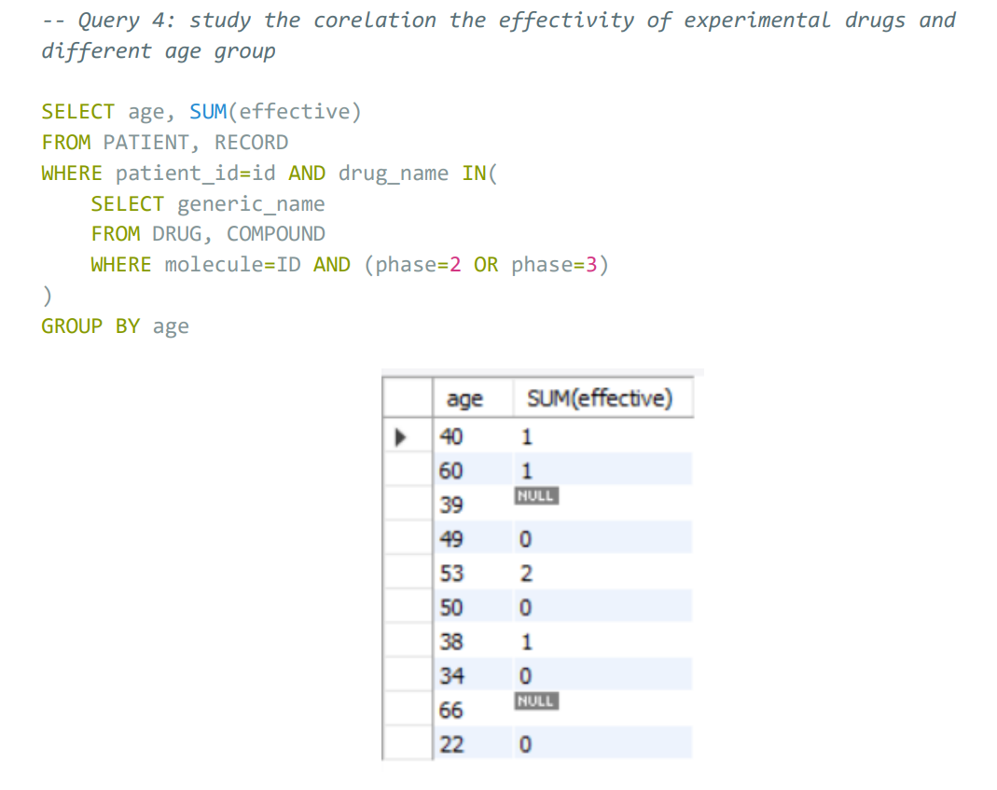
Query
This query also allows us to do a statistical test: here involves co-relation and regression, describing a relationship between effectiveness and age

Slide 21
Normalization: up to Boyce-Codd normal form
1NF: values are atomic
2NF: every non-key attribute is functionally dependent on the primary key
3NF: no transitive functional dependency
BCNF: every functional dependency rely on the super key

Slide 22

Views and Users
Who's going to use and view this database?

Slide 23

Users:
pharmacologists, chemists would be GRANTED privileges on VIEW tables COMPOUND and DRUG to access and modify them

Slide 24

Users:
Medical geneticists, physicians and biotechnologists would be GRANTED privileges on VIEW tables GENE, DISEASE and VARIANT to access and modify them

Slide 25

Users:
Process chemists, statisticians and drug metabolism specialists would be GRANTED privileges on VIEW tables COMPOUND, DRUG, GENE, DISEASE and VARIANT only to access them

Slide 26

Users:
Human Resources would be GRANTED privileges on VIEW tables PATIENT and RECORDS to access and insert new data

Slide 27

References
Sun, W., Zheng, W., & Simeonov, A. (2017). Drug discovery and development for rare genetic disorders. American journal of medical genetics. Part A, 173(9), 2307. https://doi.org/10.1002/ajmg.a.38326
Wooller, S. K., Benstead-Hume, G., Chen, X., Ali, Y., & Pearl, F. M. (2017). Bioinformatics in translational drug discovery. Bioscience Reports, 37(4). https://doi.org/10.1042/BSR20160180

